Slide 1
Overall Structure
1” Thick Strong Metal Frame
LED Chain (High Power)
Very High Quality Glass Sheet
0.5 – 1cm thick
4’
D/C Adapter
4’
4 Metal Clamps
A/C Power Supply
Wooden Table (Very Strong)
6’
6 Very Strong Legs
2’
Metal Clamp
6’
2’6”

Slide 2
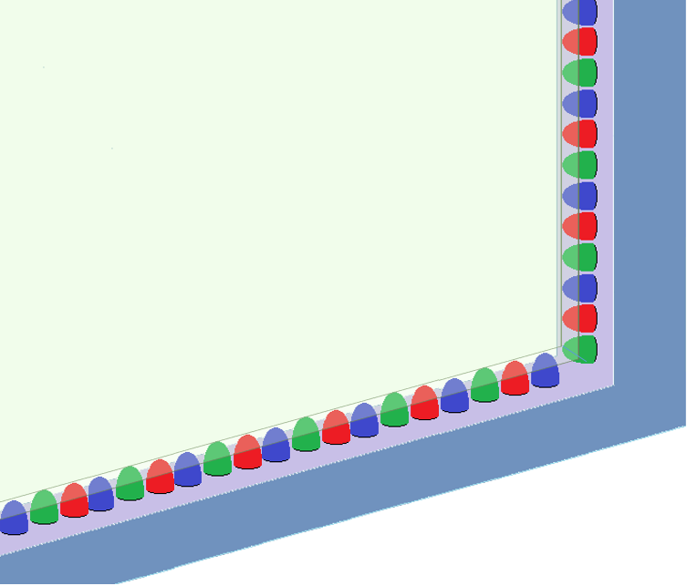
LED Strip Alignment
1” Thick Strong Metal Frame
LED Strip / Chain (High Power)
Alternating Red Green Blue colours
Focusing towards glass
A for Apple
Very High Quality Glass Sheet
0.5 – 1cm thick
Teacher’s writing glow like neon
Light entering from all sides into glass from focused LEDs

